Slide 1
KAGGLE COMPETITION · KLAB MACHINE LEARNING COURSE
Spaceship Titanic
Predicting who was transported to another dimension — from a naive baseline to a validated, leakage-free ensemble.
Justine Umutoni
PROJECT TARGET
FINAL LEADERBOARD
0.80
0.81014
stated goal
+1.01 pts above target
01

Slide 2
THE CHALLENGE
A small dataset, a binary label, no easy shortcuts
8,693
4,277
13
50.4 / 49.6
Training rows
Test rows (hidden label)
Original columns
Class balance (%)
The task
In the year 2912, the Spaceship Titanic collided with a spacetime anomaly and roughly half its passengers were transported to an alternate dimension. Using damaged records recovered from the ship's computer — demographics, cabin, and spending history — the task is to predict, for each passenger, whether they were transported. The metric is plain classification accuracy: the share of the 4,277 test passengers labelled correctly.
02

Slide 3
WHAT THE DATA TOLD US
Four patterns that shaped every feature decision
1
Group behaviour
The first half of PassengerId identifies a travel group. Passengers in the same group share outcomes far more often than chance.
2
Missing values are informative
About 2% of every column is missing — but the missingness itself correlates with the target (e.g. missing RoomService: -4.6pp transport rate).
3
Spending is bimodal
Roughly 63% of passengers spent nothing on any amenity at all; the remaining 37% show wide variation.
4
CryoSleep dominates
Passengers in cryosleep are transported at a much higher rate than those who are not — the single strongest raw signal in the data.
03

Slide 4
FEATURE ENGINEERING
13 numeric + 6 categorical features, added and tested one at a time
KEPT
TESTED AND REJECTED
GroupLen / Solo
Travel group size, from PassengerId
Cabin_Sector (binned cabin #)
-0.0016
No measurable gain
Room / Zone / Pier
Cabin split into number, deck, side
SurnameSize (from Name)
-0.0016
Cash / CashLog
Redundant with GroupLen
Total spend, log-corrected for skew
UsedCount / ZeroSpend
Group_Agreement (naive)
-0.0058
Amenity utilisation, no-spend flag
Leakage risk, pipeline broke
HighEnd / LowEnd / HighRatio
Luxury vs. budget spending split
GroupCryoRate
+0.0007
Below noise floor
SleepZero
Feature quantity is not feature quality.
CryoSleep × ZeroSpend interaction
04

Slide 5
SIXTEEN MODELS, ONE CLEAR WINNER FAMILY
Boosting methods consistently outperformed every other family
05

Slide 6
BUILDING THE ENSEMBLE
Eight combinations tried; diversity beat raw size
Ensemble
Base Models
Weights
CV
LB
Hybrid Diverse
CatBoost + XGB + SVM
3,1,2
0.8140
0.80827
OOF Hybrid
CatBoost + XGB + LGBM
learned
0.8179
0.80710
Regularized
HGB + XGB + CatBoost
3,2,2
0.8075
0.80360
4-Model v1
DT+ET+CatBoost+LGBM
1,2,3,3
0.8148
0.80944
5-Model
+ SVM
1,2,4,3,1
0.8146
0.80991
10-Model Stack
10 base + HGB meta
learned
0.8071
0.81014
WINNER
CV 0.8164
LB 0.81014
4-Model Voting · DT + Extra Trees + CatBoost + LightGBM · weights [1, 2, 4, 3]
06

Slide 7
THE SURPRISE: HIGHEST CV WASN'T THE WINNER
Cross-validation accuracy did not reliably predict leaderboard rank
HistGradientBoosting
(overfit config)
4-Model Voting
[1, 2, 4, 3]
CV 0.8181 LB 0.80079
CV 0.8164 LB 0.81014
Gap: +0.0173
Gap: +0.0063
Highest CV of any single model — but the worst leaderboard result. Tuned too closely to the CV folds.
Lower CV than HGB alone, but the smallest CV–LB gap and the best real-world result.
Lesson: CV gains smaller than ~0.005 did not reliably translate into leaderboard gains on this dataset — repeated tuning on the same folds inflates CV without improving generalisation.
07

Slide 8
WHAT DIDN'T WORK
Documented failures — the log rewards this as much as the wins
✕
Group_Agreement feature (3 attempts)
Broke the pipeline each time — leakage and a ColumnTransformer/DataFrame mismatch. Abandoned; GroupLen already captured most of the signal.
✕
Adding SVM to the 4-model ensemble
CV dropped from 0.8164 to 0.8146 — a weak model diluted a strong ensemble.
✕
Pushing CatBoost weight to 6
CV rose to 0.8174 but LB fell to 0.80827 — classic overfitting to the CV folds.
✕
10-model stacking
CV dropped to 0.8071 — the meta-model overfit its own out-of-fold predictions. More models isn't automatically better.
✕
Surname + Cabin_Sector features
CV dropped to 0.8117 — added noise, not signal.
08

Slide 9
THE FINAL MODEL
Everything that shipped, in one place
Ensemble type
VotingClassifier (soft)
5-FOLD CV ACCURACY
0.8164
Base models
Decision Tree, Extra Trees,
CatBoost, LightGBM
Weights
[1, 2, 4, 3]
GROUPKFOLD ACCURACY
0.8135
Features
13 numeric + 6 categorical
Preprocessing
Mean/mode imputation,
StandardScaler, OneHotEncoder
LEADERBOARD ACCURACY
0.81014
Random seed
42
09

Slide 10
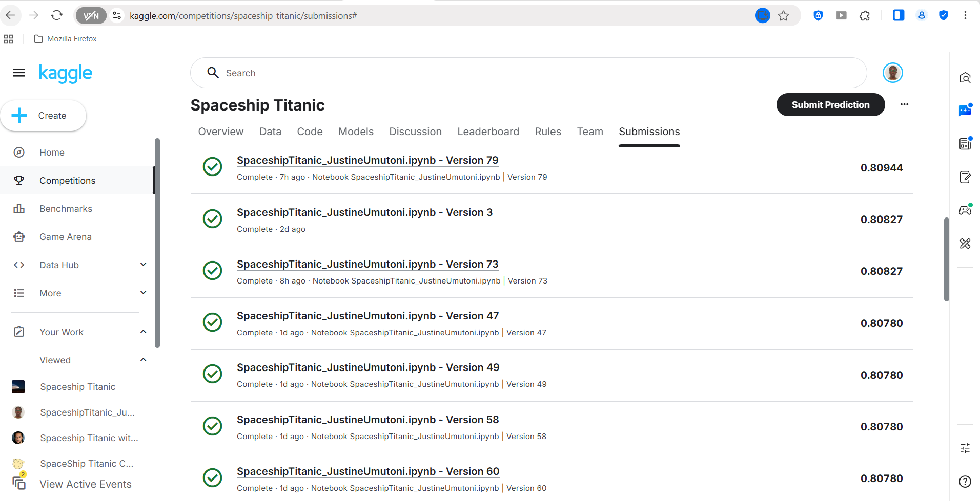
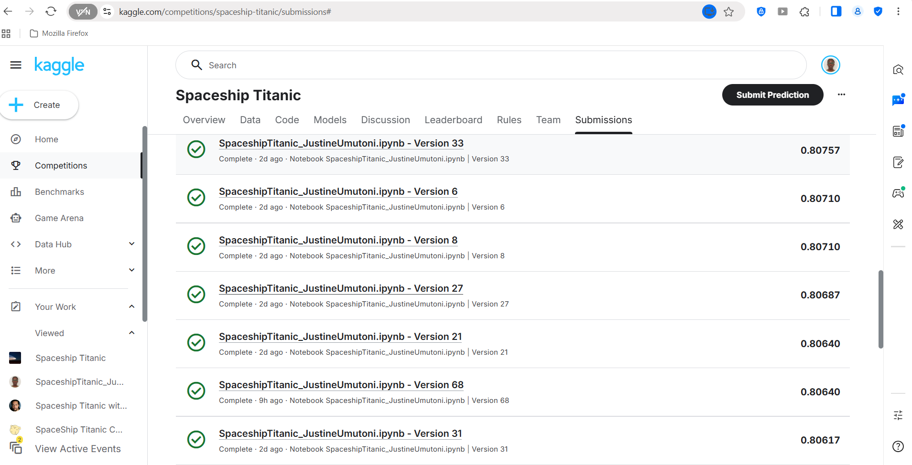
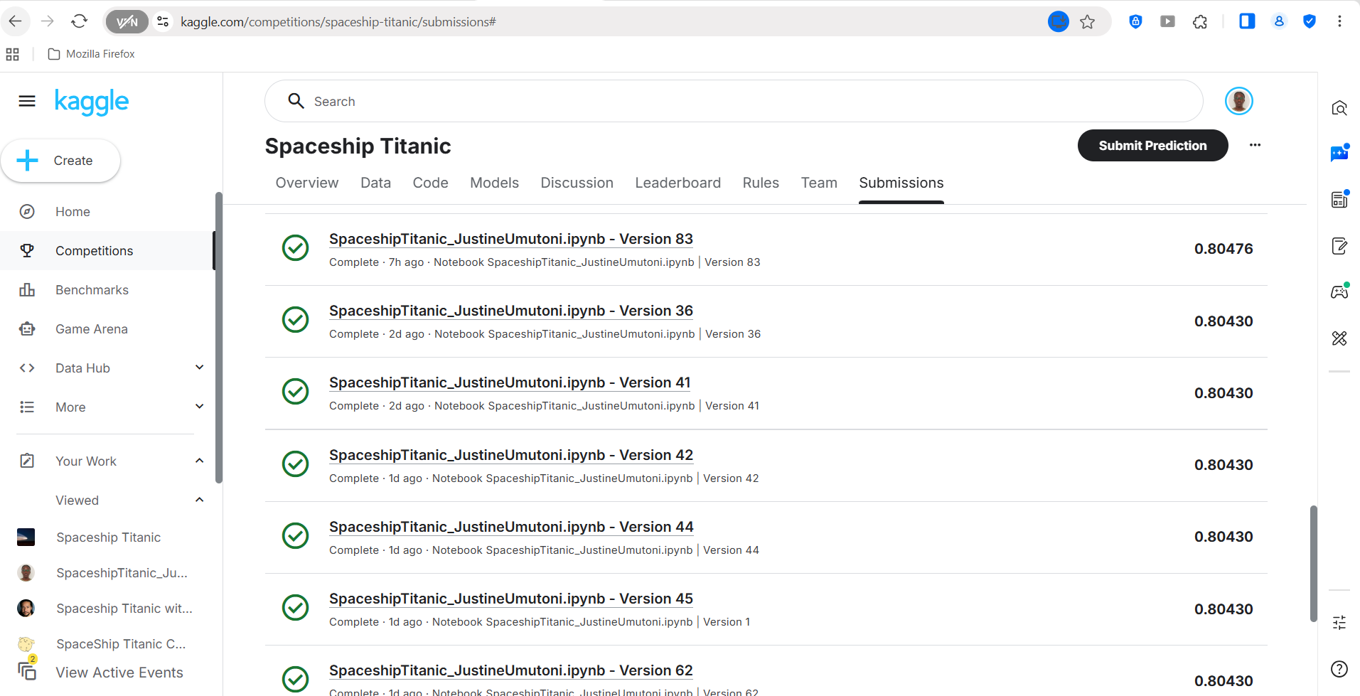
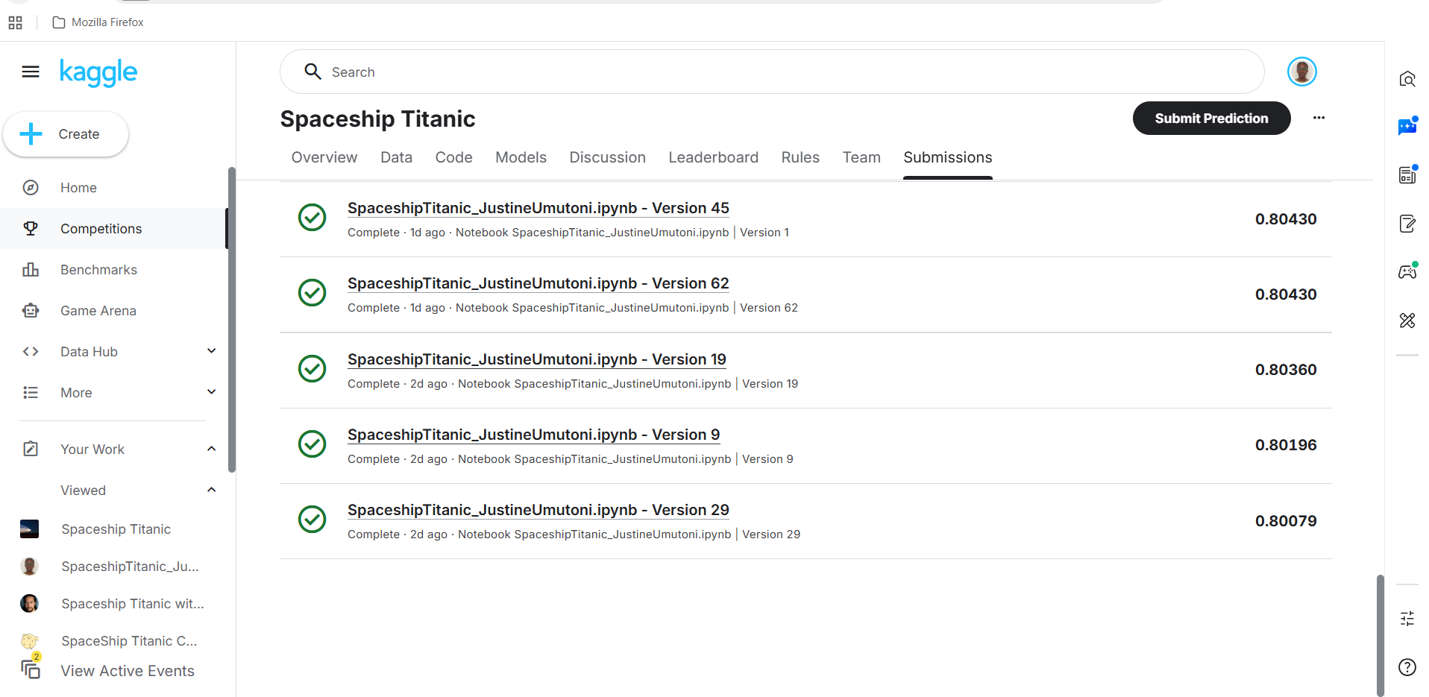
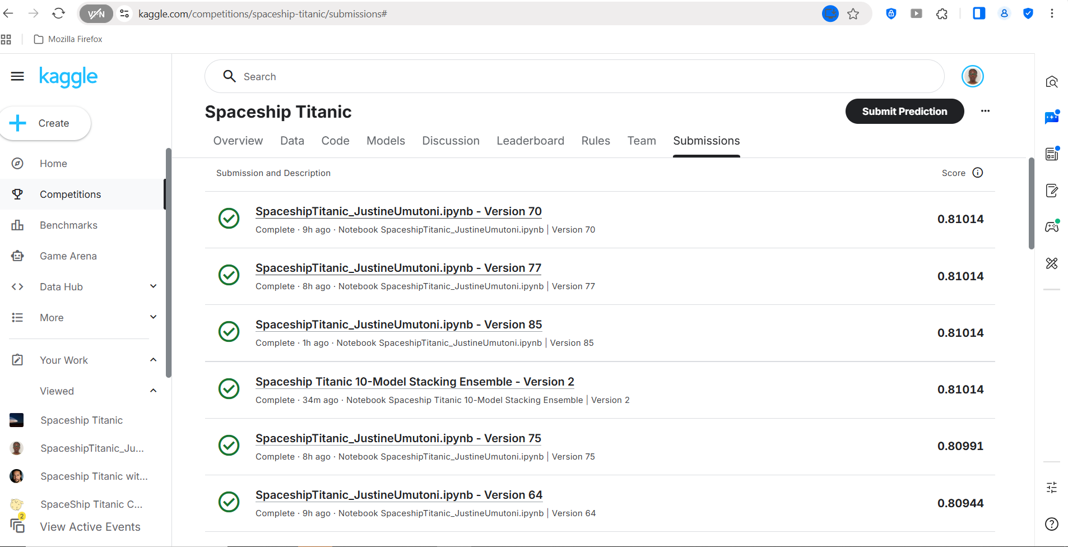
PROOF — SUBMISSION HISTORY
90 versions on Kaggle, converging on the same top score
10

Slide 11
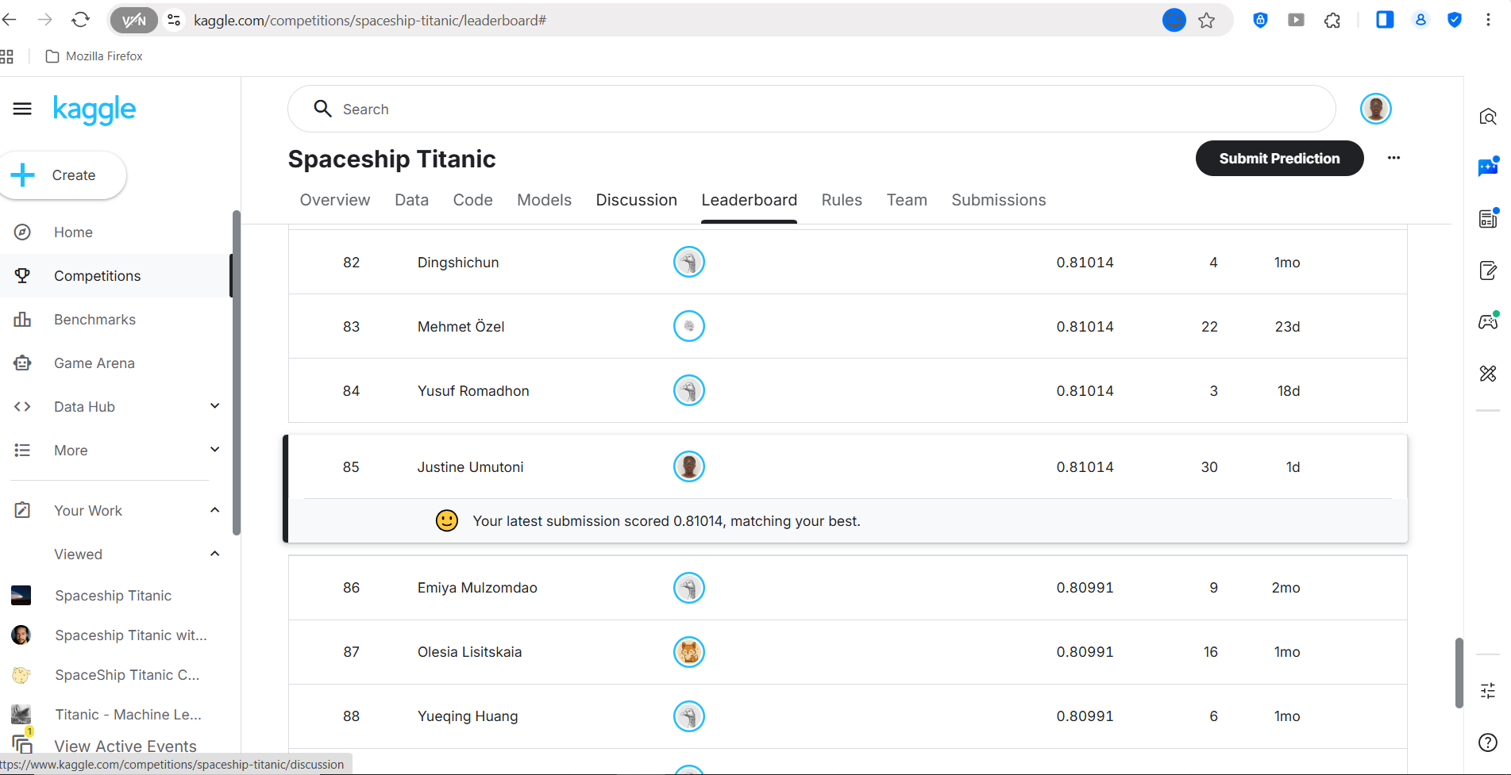
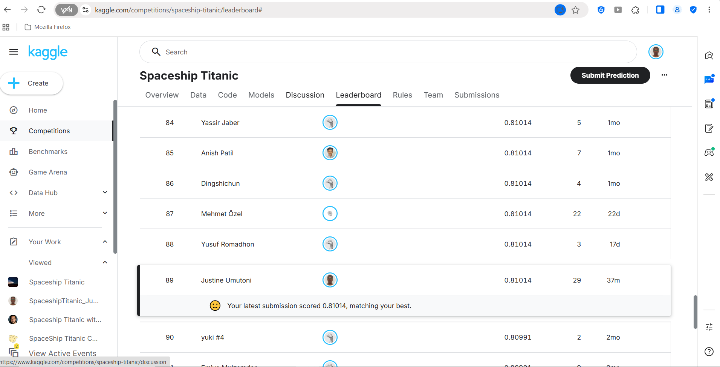
FINAL LEADERBOARD POSITION
Rank 85 · Score 0.81014 · Matching personal best
11

Slide 12
KEY TAKEAWAYS
Three things that mattered more than model choice
1
Diversity beats size
A 4-model ensemble outperformed a 10-model stack on both CV and leaderboard.
2
CV doesn't guarantee LB
The single highest-CV model produced the lowest leaderboard score of the project.
3
GroupKFold catches leakage
Comparing StratifiedKFold against GroupKFold exposed how much CV was inflated by shared travel groups.
Target 0.80 → Achieved 0.81014
+1.01 pts
12

